Slide 1

Department of Computer Science Gujarat University
Presentation on Finding Roots of Equations by Numerical Methods & Calculate Avg. Time
Prepared By :
Rajan Thakkar (10017)
Parth Karkar (10013)
Dhyanesh Bhanderi (10005)
M.sc.(Artificial Intelligence & Machine Learning)
Under the Guidance of :
Dr. Savita Gandhi

Slide 2
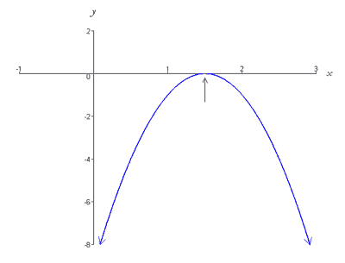
Introduction to Numerical Methods
The determination of the roots of an equation is one of the oldest problems in mathematics & there have been many efforts in this regard.
We learned numerical methods for finding roots of an equations. They represent the values of x that make f(X) equal to zero.
Thus, we can define the roots of an equation as the value of an equation as the value of x that makes f(x) = 0.
Roots are sometime called the zeros of equation.
Root
F(x)=0

Slide 3
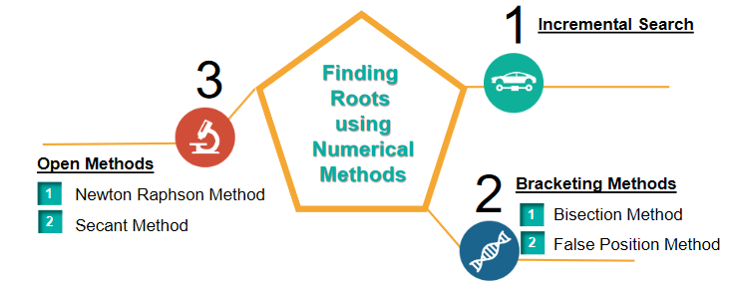
Introduction to Numerical Methods
Bracketing Methods (Need two initial estimates that will bracket the root. Always converge.)
Bisection Method
False-Position Method
Open Methods (Need one or two initial estimates. May diverge.)
Newton-Raphson Method (Needs the derivative of the function.)
Secant Method

Slide 4
Objectives
Find solutions of Non-Liner equation and Liner Equation (User can Input)
Derive the formula and follow the algorithms for the solutions of equations using the following methods:
1. Bisection
2. False-Position
3. Secant
4. Newton-Raphson
Average time Take by all the method in python as well as c++ So, we can predict the performance.
Graphical representation for better understand

Slide 5
Problem Statement
Write a Python program to find the roots of an equation of any non-liner , liner equation & use four different methods and find the root plus find the average time taken by each method.(Menu driven Program )
User will also input the first and second point.
Also user can do new equation in the program.
Output is view as Tabular format.
Graphical representation of Four numerical method
We also create c++ program for checking which language evaluation is faster.
Note:- we also use the Kotlin Language which is use to create a mobile application so, we create a mobile application and run all four method and also check the evaluation time

Slide 6
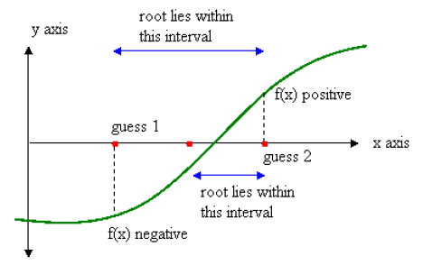
Bisection Method Algorithm
1. Start.
2. Define function f(X).
3. Choose initial guesses x0 and x1 such that f(x0)f(x1)<0.
4. Choose pre specified tolerable error e.(0.0001->4 significant digit)
5. Calculate new approximated root as x2 = (x0 + x1)/2
6. Calculate f(x0)f(x2)
a. if f(x0)f(x2) < 0 then x0 = x0 and x1 = x2
b. if f(x0)f(x2) > 0 then x0 = x2 and x1 = x1
c. if f(x0)f(x2) = 0 then go to (8)
7. if |f(x2)| > e then go to (5) otherwise go to (8)
8. Display x2 as root
9. Stop

Slide 7
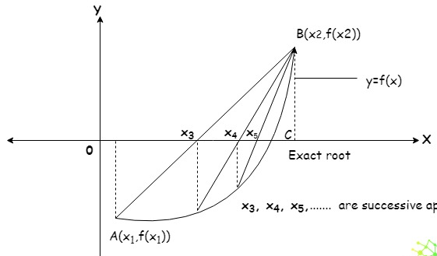
False-Position Method Algorithm
1. Start
2. Define function f(x)
3. Choose initial guesses x0 and x1 such that f(x0)f(x1) < 0
4. Choose pre-specified tolerable error e.
5. Calculate new approximated root as:
x2 = x1 * f(x2) – x2*f(x1) / f(x2) – f(x1)
6. Calculate f(x0)f(x2)
a. if f(x0)f(x2) < 0 then x0 = x0 and x1 = x2
b. if f(x0)f(x2) > 0 then x0 = x2 and x1 = x1
c. if f(x0)f(x2) = 0 then go to (8)
7. if |f(x2)|>e then go to (5) otherwise go to (8)
8. Display x2 as root.
9. Stop

Slide 8
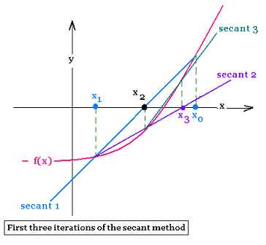
Secant Method Algorithm
1. Start
2. Define function as f(x)
3. Input initial guesses (x0 and x1), tolerable error (e) and maximum iteration (N)
4. Initialize iteration counter i = 1
5. If f(x0) = f(x1) then print "Mathematical Error" and go to (11) otherwise go to (6)
6. Calculate x2 = x1 - (x1-x0) * f(x1) / ( f(x1) - f(x0) )
7. Increment iteration counter i = i + 1
8. If i >= N then print "Not Convergent" and goto (11) otherwise goto (9)
9. If |f(x2)| > e then set x0 = x1, x1 = x2 and goto (5) otherwise goto (10)
10. Print root as x2
11. Stop

Slide 9
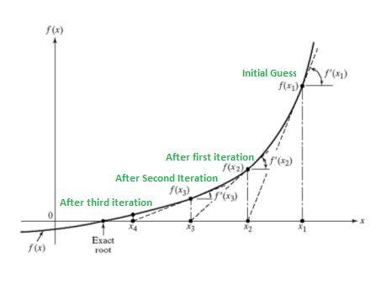
Newton Raphson Method Algorithm
1. Start
2. Define function as f(x)
3. Define first derivative of f(x) as g(x)
4. Input initial guess (x0), tolerable error (e) and maximum iteration (N
5. Initialize iteration counter i = 1
6. If g(x0) = 0 then print "Mathematical Error" and goto (12) otherwise goto (7)
7. Calculate x1 = x0 - f(x0) / g(x0)
8. Increment iteration counter i = i + 1
9. If i >= N then print "Not Convergent" and go to (12) otherwise go to (10)
10. If |f(x1)| > e then set x0 = x1 and go to (6) otherwise go to (11)
11. Print root as x1
12. Stop

Slide 10
Time Module
Time Module to calculate the execution time of every method every iteration and after calculate average of all iteration of every method.
We use perf_counter() method to calculate the time.
Basically it will work like counter when we start function than we called this function and when function over then we store value of end time.
Than we difference two of them and we find the total time take by that function
import time
start_time = time.perf_counter()
if f(x1) * f(x2) < 0.0:
...
else:
…
end_time = time.perf_counter()
diff=end_time - start_time
print(f"Execution Time is : {diff:0.6f} seconds")

Slide 11
Graph Plotting
import matplotlib.pyplot as plt
matplotlib library which have pyplot module so that we can use graph in python
def graph(ls):
plt.plot(*zip(*sorted(ls.items())))
# sorted() sorted by key, return a list of tuples
# Zip() unpack a list of pairs into two tuples
# items() Function show keys and values
#Spines are the lines connecting the axis tick marks and noting the boundaries of the data area. ax.spines['right'].set_position('center')

Slide 12
Graph Plotting
ax.set_ylim([-20, 20])
#ylim() Function. The ylim() function in pyplot module of
#matplotlib library is used to get or set the y-limits of the current axes
plt.title('Numerical Methods ')
plt.show() #Show() use for display the graph
Above is the function which have one argument that is dictionary (ls) which have new point as key and their point’s function evolution as value.
ls = dict()
ls.update({x3:f(fu,x3)}) so, this is the way to show the graph of each of the numerical method

Slide 13
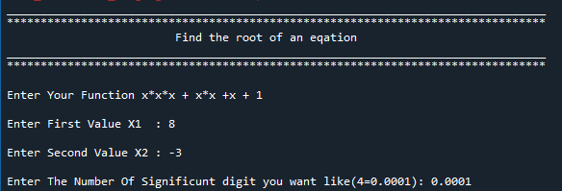
Input Screen (which user can give an equation)

Slide 14
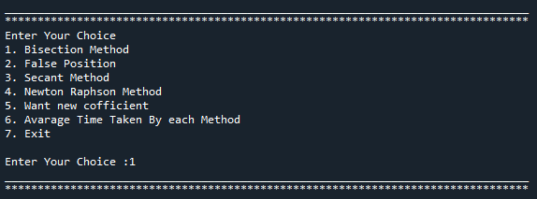
Menu For Different operation

Slide 15
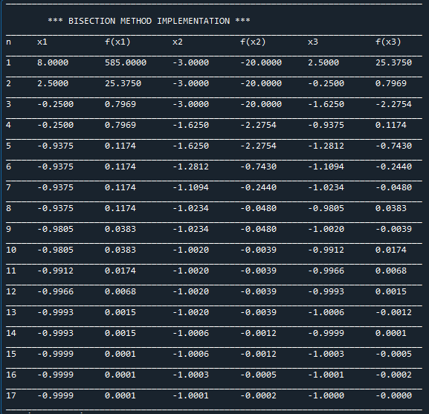
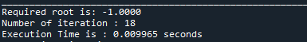
OUTPUT FOR BISECTION METHOD

Slide 16
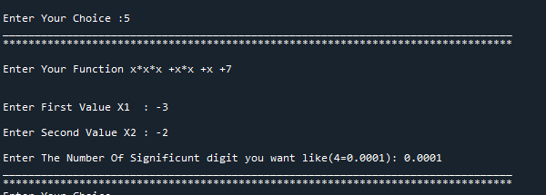
ENTER NEW COEFFICIENT

Slide 17
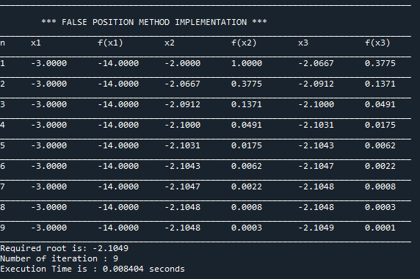
OUTPUT FOR FALSE POSITION METHOD

Slide 18
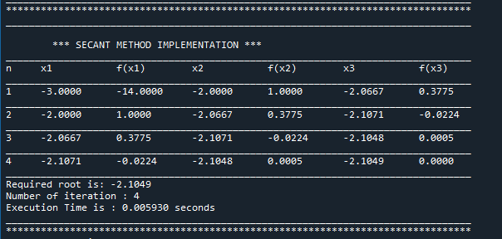
OUTPUT FOR SECANT METHOD

Slide 19
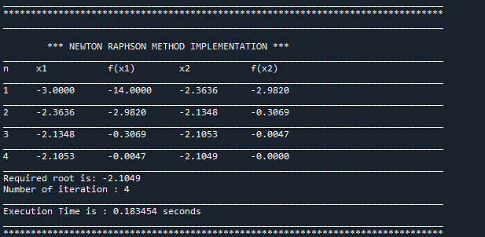
OUTPUT FOR NEWTON RAPHSON METHOD

Slide 20
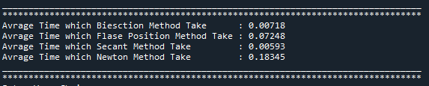
RESULT(FOR AVERAGE TIMING)

Slide 21
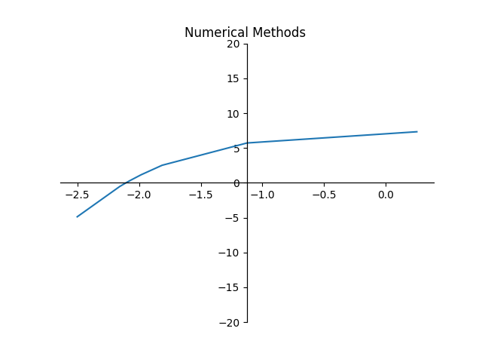
Graph Bisection
X Axis – new Iteration value
Y Axis - F(x) where x = new iteration value

Slide 22
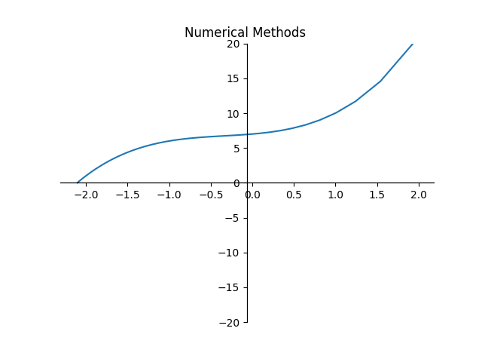
Graph False Position Method
X Axis – new Iteration value
Y Axis - F(x) where x = new iteration value

Slide 23
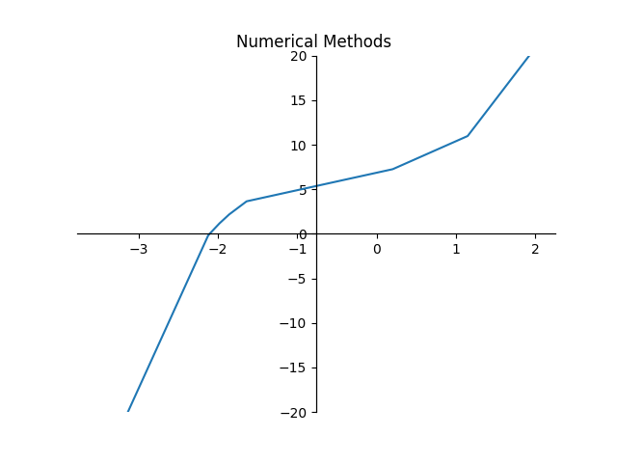
Graph Secant Method
X Axis – new Iteration value
Y Axis - F(x) where x = new iteration value

Slide 24
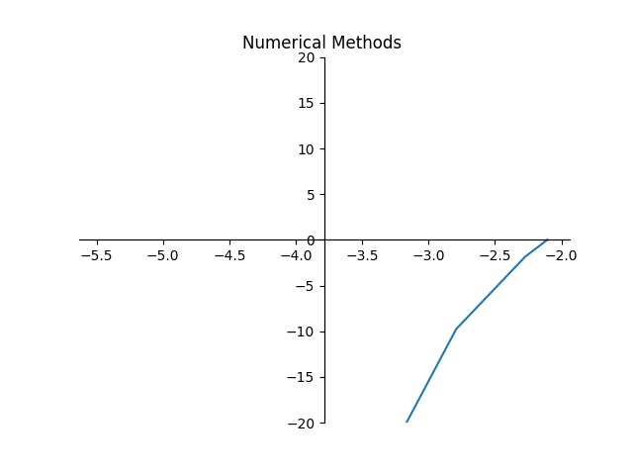
Graph Newton Raphson Method
X Axis – new Iteration value
Y Axis - F(x) where x = new iteration value

Slide 25
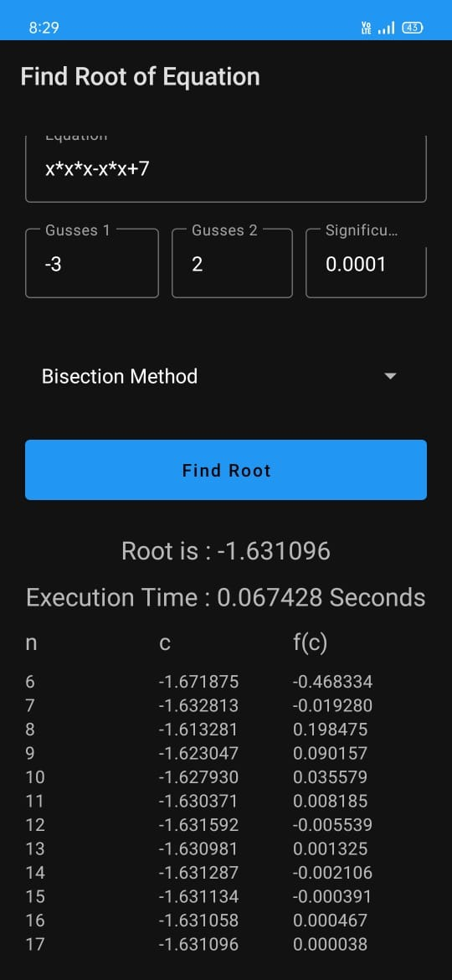
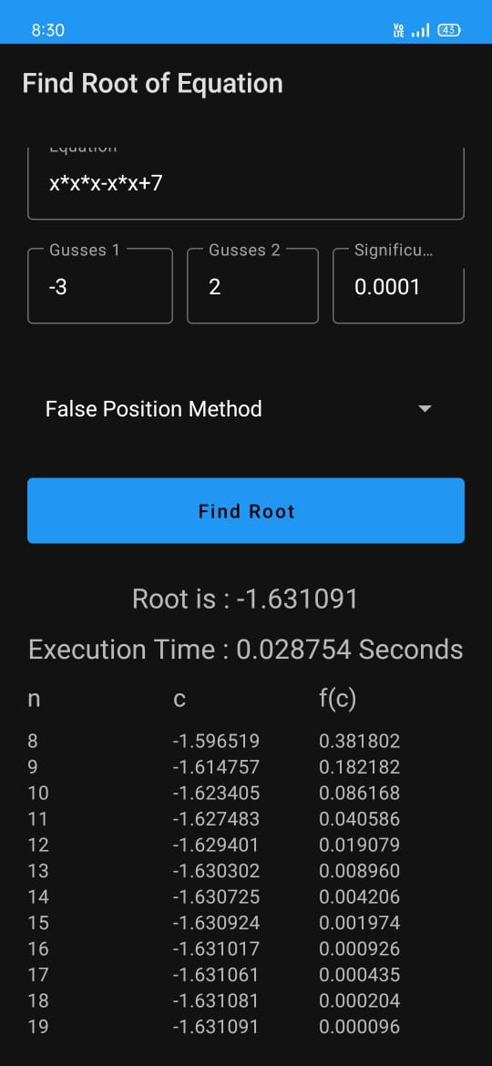
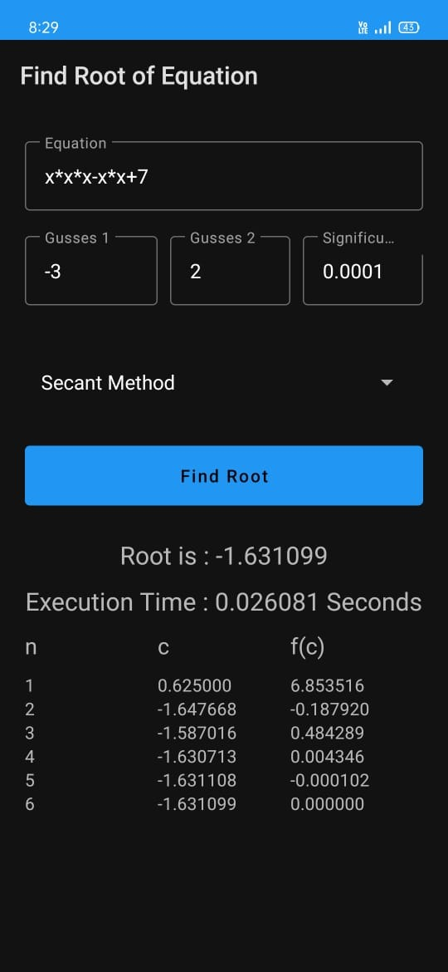
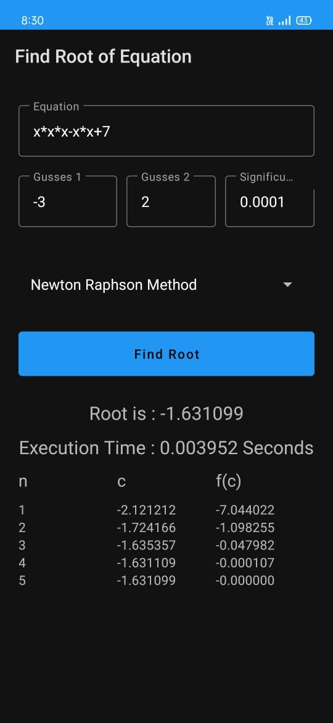
Kotlin Application Output (App)

Slide 26
Comparisons between C++ & Python & Kotlin (App) (Time Wise)
x*x*x+x*x+x+1 | x1=8 x2=-3 | 0.0001
 | Python | C++ | Kotlin(App)
Bisection | 0.004 | 0.073 | 0.050016
False Position | 0.327 | 0.521 | 0.133367
Secant | 0.0035 | 0.023 | 0.009437
Newton Raphson | 0.098 | 0.047 | 0.026898

Slide 27
Comparisons between C++ & Python (Time Wise)
1

Slide 28
Comparisons between C++ & Python (Time Wise)
2

Slide 29
Comparisons between C++ & Python (Time Wise)
3

Slide 30
Comparisons between C++ & Python (Time Wise) avg. of above 3
4

Slide 31
Comparisons of iteration for each method
ITERATION

Slide 32
CONCLUSION
FROM ABOVE OBSERVATIONS WE CONCLUDE THAT AVERAGE TIME TAKEN BY THE SECANT METHOD IS LESS AMONG ALL THE METHOD (IN PYTHON).
AND AVERAGE TIME TAKEN BY THE NEWTON RAPSHON MATHOD IS LESS AMONG THE ALL METHOD (IN C++).
AND AVERAGE TIME TAKEN BY PYTHON IS LESS THEN THE C++.
PYTHON IS FASTER THEN C++ TO SOLVE THE NUMARICAL METHODS.
ALSO WE CAN CONCLUDE THAT NEWTON RAPSHON METHOD HAVE LESS ITERATION IN BOTH PYTHON AND C++.

Slide 33
Future Details
Using Django, we can also put this method online or create webpage.
Automatically Take an initial guess of method.
Use ML algorithm or method to solve an equation

Slide 34
References
https://www.codesansar.com/numerical-methods/ (1)
Introductory methods of numerical analysis , Sastry, S.S. , , PHI Learning Private Limited ,2015 (2)
https://www.epythonguru.com/2019/12/how-to-find-derivatives-in-python.html (3)

Slide 35
THANK YOU

